Slide 1
How Can a Wellness Technology Company Play It Smart?
Data From Kaggle
Five River Groups Inc
2016

Slide 2
Problem:
Don’t have a insight user habit data
Solution:
Analysis data set and create summary insight data

Slide 3
Analysis Goal
What : what is insight habit of user
How: analyze a habit and summary trend

Slide 4
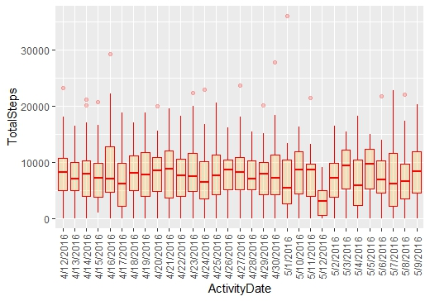
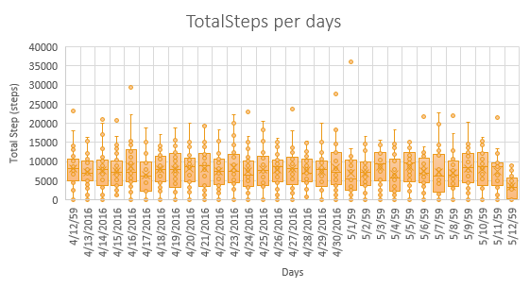
Activity Insight of User Habit
Average Total step in each day is 7,638 steps

Slide 5
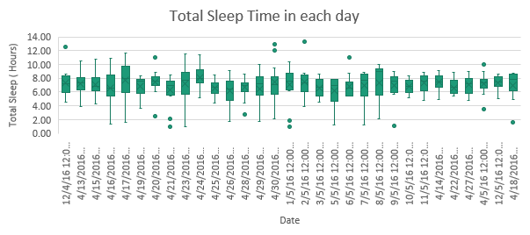
Sleep Insight of User Habit
Average Total Sleep of User is 7 hours per days

Slide 6
BMI Insight of User
Average BMI of User is 25.19 point

Slide 7
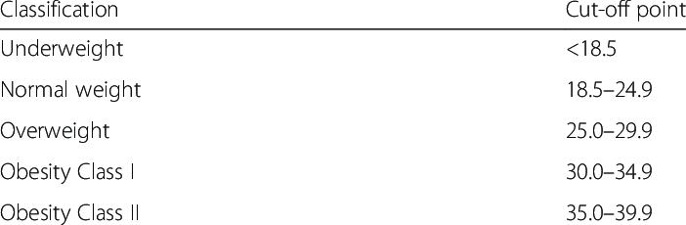
Healthy Guide
“Adults who ages between 18-60 years should Sleep 7 or more hours per night to get better health”
CDC's World Health Organization (WHO)
“Adults should aim for 10,000 steps per days to get better health”
CDC's World Health Organization (WHO)
BMI (Body mass index)
GOOD
World Health Organization (WHO)

Slide 8
How to smart plays?
Current
Future
Solution
63 % of User
< 10,000 steps
Total step
Guide knowledge of Healthy and Create a smart Program to alert user when don’t achieve in the healthy process
Decrease unhealthy user
Total Sleep
44% of User
< 7 Hours
BMI
49% of User
> 24.9 point

Slide 9
Timeline of Events
2022
2023
11
12
01
02
W1
W2
W3
W4
W1
W2
W3
W4
W1
W2
W3
W4
W1
W2
W3
W4
Analysis
Present Analysis
Strategy and promote campaign
Following& iteration
Launch

Slide 10
Further Exploration for v2
What is the impact of user healthy
What is the suitable of activity exercise in each person

Slide 11
Thank you

